Slide 1
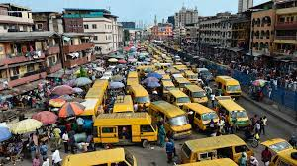
IMPACT OF URBANIZATION ON BIODIVERSITY
GROUP 1

Slide 2
OUTLINE
DEFINITION OF URBANIZATION AND ITS DRIVERS
BIODIVERSITY AND ITS IMPORTANCE
NEGATIVE IMPACTS OF URBANIZATION ON BIODIVERSITY
CASE STUDY
MITIGATION AND CONSERVATION STRATEGIES
CONCLUSION
REFERENCES

Slide 3
URBANIZATION AND ITS DRIVERS
Urbanization is the process by which an increasing proportion of a population live in cities and towns leading to the growth of urban areas.
Drivers of urbanization: population growth, industrialization, rural-to-urban migration.
The process of urbanization may lead to loss of biodiversity specifically beta diversity.

Slide 4
BIODIVERSITY AND ITS IMPORTANCE
Biodiversity encompasses the variety of life on earth, including genes, species and ecosystems.
Levels of biodiversity: species diversity, genetic diversity and ecosystem/habitat diversity.
Importance: provides essential ecosystem services including pollination, nutrient cycling and climate regulation.

Slide 5
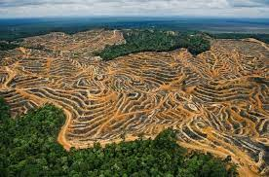
NEGATIVE IMPACTS OF URBANIZATION ON BIODIVERSITY
Habitat loss and fragmentation
Urbanization and habitat destruction
Fragmentation effects: the division of habitats into smaller patches can lead to reduced genetic diversity and increased vulnerability.
Fig.1 Habitat Fragmentation

Slide 6
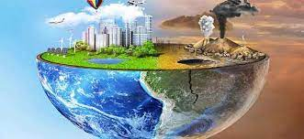
NEGATIVE IMPACTS CONT’D
Pollution
Air pollution, water pollution, light pollution etc.
Impact on biodiversity: disruption of food chains, degrade ecosystems, harm to wildlife health.
Mitigation efforts: efforts to reduce pollination and create sustainable urban environments.
Fig. 2 Pollution

Slide 7
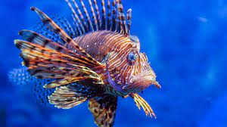
NEGATIVE IMPACTS CONT’D
Invasive species
Urban areas serve as gateways for the introduction and dispersal of invasive species.
Negative effects: disruptions of ecosystems, alteration of natural processes, etc.
Management: implementing strategies to control invasive species and prevent their spread in urban environments.
Fig. 3 an invasive specie

Slide 8
NEGATIVE IMPACTS CONT’D
Altered ecological processes
Disruption of natural processes.
Effects: altered ecological processes can impact species abundance, distribution and interactions.
Mitigation efforts: initiatives to restore natural processes in urban settings.

Slide 9
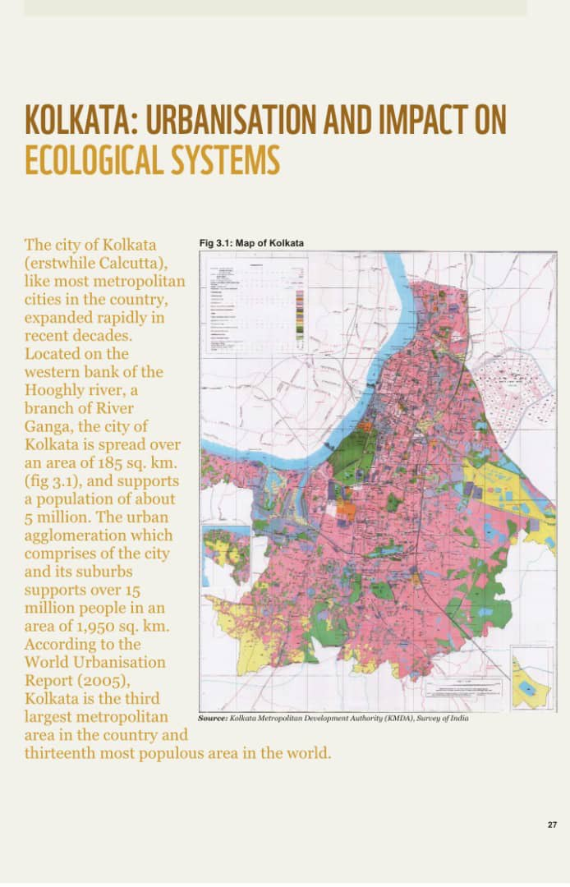
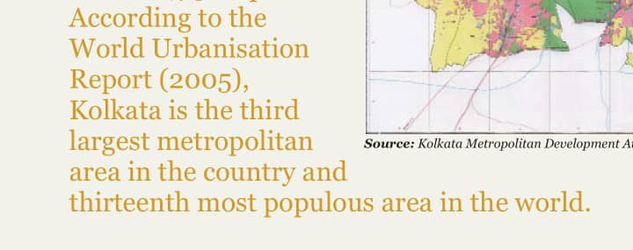
CASE STUDY: Kolkata: Urbanization and Impact on Ecological Systems
Fig. 3a
Fig. 3b

Slide 10
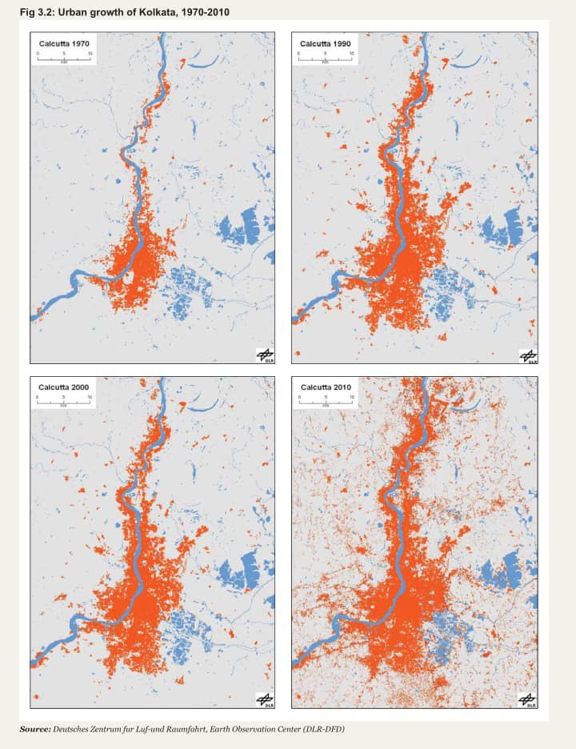
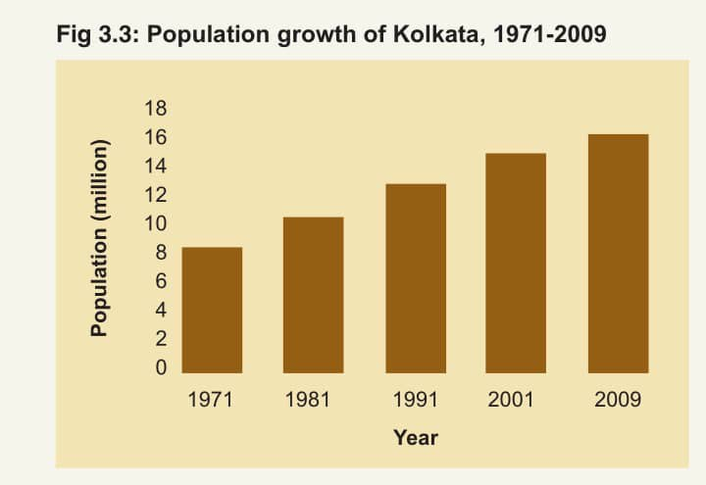
CASE STUDY CONT’D
Fig. 3c
Fig. 3d

Slide 11
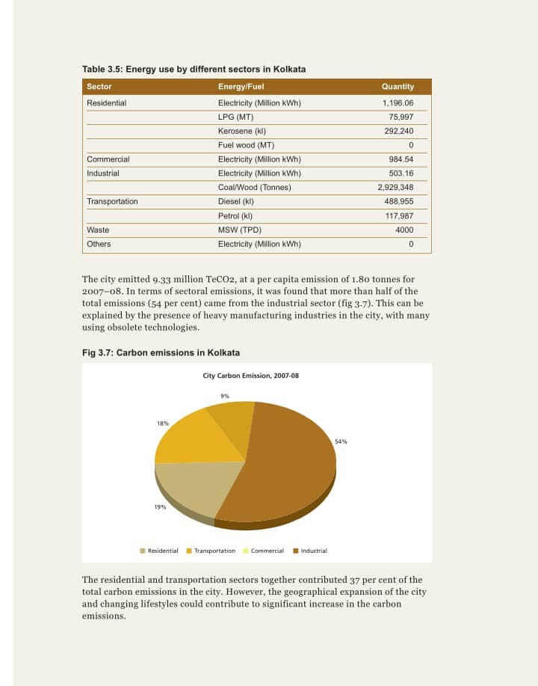
CASE STUDY CONT’D
Fig. 3e

Slide 12
MITIGATION AND CONSERVATION STRATEGIES
Public awareness and education
Urban planning for biodiversity conservation
Creation of urban green spaces
Wildlife corridors and connectivity
Community engagement and citizen science

Slide 13
CONCLUSION
Urbanization impacts biodiversity through habitat loss, pollution, invasive species, and altered ecological processes.
We must take action to protect biodiversity in urban areas for the well being of both wildlife and humans.
Together we can build sustainable and biodiverse cities for a healthier planet.

Slide 14
REFERENCES
United Nations. (2018). World Urbanization Prospects: The 2018 Revision. Department of Economic and Social Affairs, Population Division. New York.
Secretariat of the Convention on Biological Diversity. (2010). Global Biodiversity Outlook 3. Montreal, Canada.
Grimm, N. B., Foster, D., Groffman, P., et al. (2008). The Changing Landscape: Ecosystem Responses to Urbanization and Pollution across Climatic and Societal Gradients. Frontiers in Ecology and the Environment, 6(5), 264-272.
McKinney, M. L. (2008). Effects of Urbanization on Species Richness: A Review of Plants and Animals. Urban Ecosystems, 11(2), 161-176.
Theobald, D. M. (2005). Landscape Patterns of Exurban Growth in the USA from 1980 to 2020. Ecology and Society, 10(1), 32.
McKinney, M. L., & Lockwood, J. L. (1999). Biotic Homogenization: A Few Winners Replacing Many Losers in the Next Mass Extinction. Trends in Ecology & Evolution, 14(11), 450-453.

Slide 15
GROUP MEMBERS
ADJEI CHRISTIAN – 9194919
OWUSU VICENTIA DARKWAAH - 9217019
ASIEDU PRECIOUS – 9202819
ADDO VERA – 9194619
ASARE BAFFOUR DERRICK – 9202319
ANNAN SAMUEL – 9200219
PEARL GYENING – 9208919
ANSAH YVETTE AFARIBEA AFIA – 9200719
KLAY SELASIE FRANKLYN - 9210719

Slide 16
THANK YOU

